Slide 1
Conditional statements and comparison operators

Slide 2
Outline
In this lesson, we will:
Describe the need for executing code conditionally
Describe the flow chart and emphasize the purpose of flow charts
Describe the conditional statement
The absolute-value and max functions
Look at multiple conditional statements
Clipping and the tent function
Finally, concluding with a simulation of the operational amplifier

Slide 3
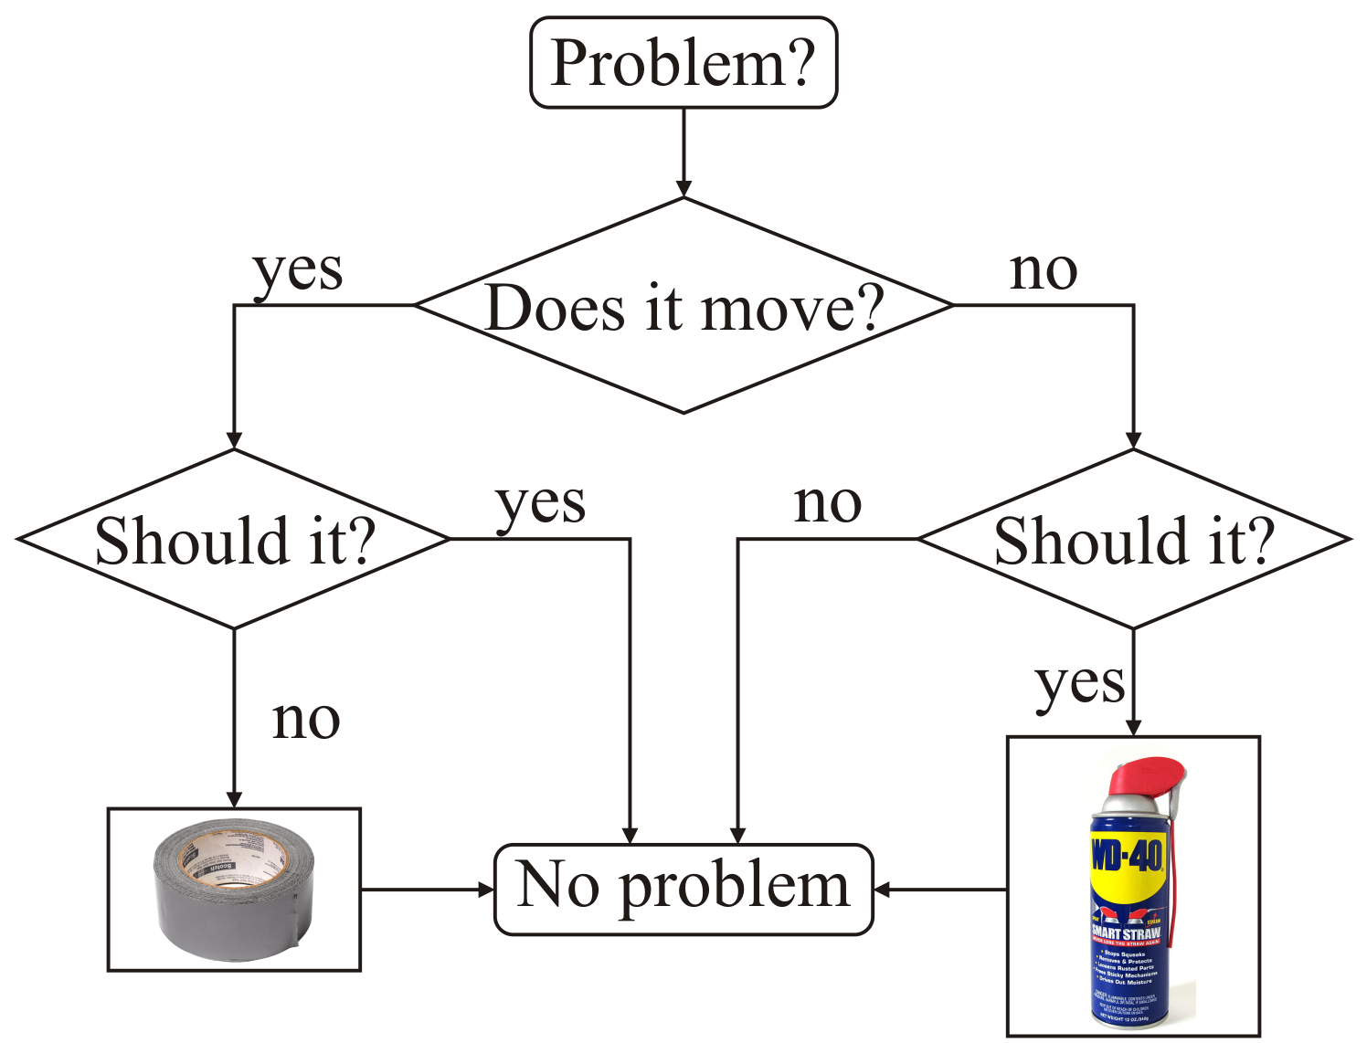
Conditional statements
In programming, we can conditionally execute code if some condition—a Boolean-valued statement—is satisfied (i.e., true)

Slide 4
Conditional statements
Up to this point, we have focused on examples with serial execution
Each statement in the program is executed one statement at time
Suppose we only want to execute a statement if a condition is true
For example, we may ask the user for a value and then execute code based on that value

Slide 5
Conditional statements
Here is an example:
#include <iostream>
// Function declarations
int main();
// Function definitions
int main() {
double x{};
std::cout << "Enter a number 'x': ";
std::cin >> x;
if ( x >= 0 ) {
std::cout << "|x| = " << x << std::endl;
} else {
std::cout << "|x| = " << (-x) << std::endl;
}
return 0;
}
If the user entered a positive number,
the first block of statements is executed;
otherwise, the second block of statements is executed.

Slide 6
Conditional statements
In order to choose which block of code to execute based on a given condition, we use a conditional statement:
if ( Boolean-valued condition ) {
// The consequent block or body of statements
// - to be executed if the condition is true
} else {
// The alternative block or body of statements
// - to be executed if the condition is false
}
Even though a conditional statement may have many statements within it, the entire structure is referred to as a conditional statement

Slide 7
Conditional statements
In order to execute code only if some condition is satisfied, we use a conditional statement:
if ( Boolean-valued condition ) {
// The consequent block or body of statements
// - to be executed if the condition is true
}

Slide 8
Conditional statements
A Boolean-valued condition is any test that returns true or false
We will look at six such conditions:
These are called the binary comparison operators
Each takes two operands, each returns true or false
Operator | Example
Less than | x < y
Greater than | x > y
Less-than or equal to | x <= y
Greater-than or equal to | x >= y
Equals | x == y
Does not equal | x != y

Slide 9
Conditional statements
It is incredibly important to remember that to test equality,
you must use the == operator and not the = operator
The = operator is the assignment operator
You must use <= and >=
You cannot use =< and =>
Write it as you say it:
Think of “!” as meaning not
Thus, the != operator is the not equals operator
Less than
or equal to
<
=

Slide 10
The max function
As a second example, the maximum of two values is also based on a simple condition:
Let’s write a program that prints the maximum of two values:

Slide 11
The max function
Here is an implementation:
#include <iostream>
// Function declarations
int main();
// Function definitions
int main() {
double x{};
std::cout << "Enter a number 'x': ";
std::cin >> x;
double y{};
std::cout << "Enter a number 'y': ";
std::cin >> y;
if ( x >= y ) {
std::cout << "max(x, y) = " << x << std::endl;
} else {
std::cout << "max(x, y) = " << y << std::endl;
}
return 0;
}

Slide 12
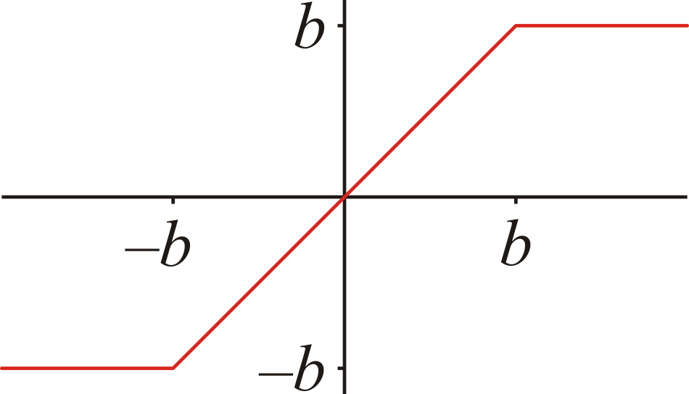
Clipping signals
In engineering, signals (values) often cannot exceed certain bounds
If a signal x is greater in absolute value than some bound b,
the bound is returned

Slide 13
Clipping signals
Here is an implementation:
// Function definitions
int main() {
double x{};
std::cout << "Enter a number 'x': ";
std::cin >> x;
double bound{};
std::cout << "Enter a bound: ";
std::cin >> bound;
if ( x >= bound ) {
std::cout << "clip(x) = " << bound << std::endl;
} else {
// x < bound
if ( x <= -bound ) {
std::cout << "clip(x) = " << (-bound) << std::endl;
} else {
std::cout << "clip(x) = " << x << std::endl;
}
}
return 0;
}

Slide 14
Clipping signals
In this example, there are three non-overlapping cases:
When x ≥ b
When x ≤ –b
When –b < x < b
We can instead write such a conditional statement as
if ( x >= bound ) {
std::cout << "clip(x) = " << bound << std::endl;
} else if ( x <= -bound ) {
std::cout << "clip(x) = " << -bound << std::endl;
} else {
// If neither of the two previous conditions
// is true, then -bound < x < bound
std::cout << "clip(x) = " << x << std::endl;
}

Slide 15
Cascading conditional statements
Such a sequence of if—else-if—··· statements is referred to as
cascading conditional statements
if ( condition-1 ) {
// First consequent block
// Do something
} else if ( condition-2 ) {
// Second consequent block
// Do something else
} else {
// Complementary
// alternative block
// Do something else,
// yet again...
}
Martin Püschel, Song Khon Waterfall

Slide 16
Cascading conditional statements
You can have as many conditions as is deemed necessary
if ( condition-1 ) {
// First consequent block
// Do something
} else if ( condition-2 ) {
// Second consequent block
// Do something else
} else if ( condition-3 ) {
// Third consequent block
// Do something else
} else {
// Complementary
// alternative block
// Do something else,
// yet again...
}
Martin Püschel, Song Khon Waterfall

Slide 17
Cascading conditional statements
As before, it is not necessary to have a
complementary alternative block
if ( condition-1 ) {
// First consequent block
// Do something
} else if ( condition-2 ) {
// Second consequent block
// Do something else
} else if ( condition-3 ) {
// Third consequent block
// Do something else
}
Martin Püschel, Song Khon Waterfall

Slide 18
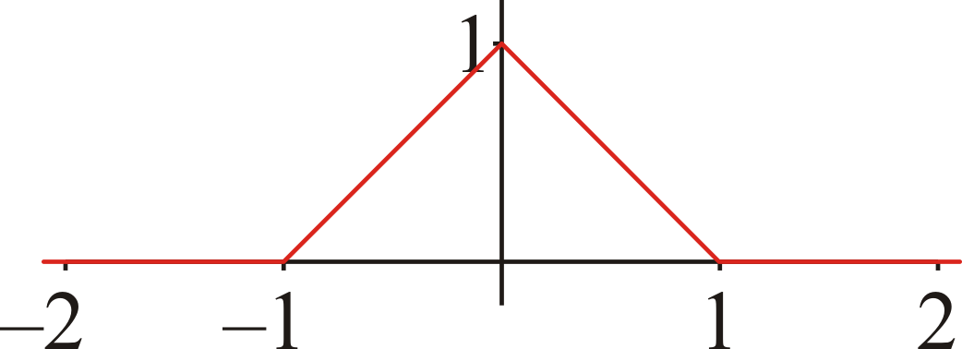
The tent function
A tent function is defined as:

Slide 19
Cascading conditional statements
Here is an implementation:
// Function definitions
int main() {
double x{};
std::cout << "Enter a number 'x': ";
std::cin >> x;
if ( x <= -1.0 ) {
std::cout << "tent(x) = " << 0.0 << std::endl;
} else if ( x <= 0.0 ) {
std::cout << "tent(x) = " << (x + 1.0) << std::endl;
} else if ( x <= 1.0 ) {
std::cout << "tent(x) = " << (1.0 - x) << std::endl;
} else {
std::cout << "tent(x) = " << 0.0 << std::endl;
}
return 0;
}
Once a condition is checked and evaluates to true, no subsequent conditions are checked

Slide 20
How not to use cascades
Novice programmers sometimes want to emphasize the conditional checks:
Don’t do this:
The second condition is complementary to the first
Experienced programmers reading this will be confused
They expect that there are some values of x that satisfy neither condition
Maintenance becomes more difficult
if ( x <= 0 ) {
// Do something...
} else if ( x > 0 ) {
// Do something else...
}
if ( x == 0 ) {
// Do something...
} else if ( x != 0 ) {
// Do something else...
}

Slide 21
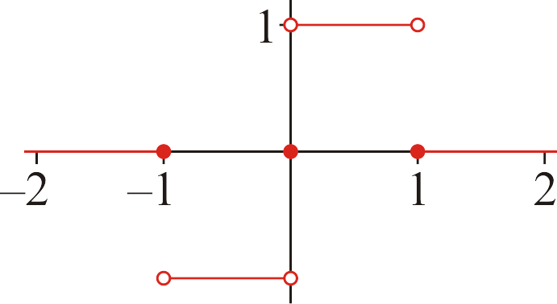
Common errors with cascades
Consider this code:
if ( x < -1.0 ) {
std::cout << 0.0;
} else if ( x < 0.0 ) {
std::cout << -1.0;
} else if ( x > 0.0 ) {
std::cout << 1.0;
} else if ( x > 1.0 ) {
std::cout << 0.0;
} else {
std::cout << 0.0;
}
What are the errors in this cascade?

Slide 22
Summary
Following this lesson, you now:
Understand the format of a conditional statement:
A Boolean-valued condition
A consequent block of statements to be executed if the condition is true
An alternative block of statements to be executed if the condition is false
Know that the condition may be a comparison:
One of six comparison operators with two operands
Understand alternative block is not required
Know how to have a cascading conditional statement with two or more conditions, each with their own associated block of statements

Slide 23
References
[1] Wikipedia
https://en.wikipedia.org/wiki/Conditional_(computer_programming)

Slide 24
Colophon
These slides were prepared using the Georgia typeface. Mathematical equations use Times New Roman, and source code is presented using Consolas.
The photographs of lilacs in bloom appearing on the title slide and accenting the top of each other slide were taken at the Royal Botanical Gardens on May 27, 2018 by Douglas Wilhelm Harder. Please see
https://www.rbg.ca/
for more information.

Slide 25
Disclaimer
These slides are provided for the ece 150 Fundamentals of Programming course taught at the University of Waterloo. The material in it reflects the authors’ best judgment in light of the information available to them at the time of preparation. Any reliance on these course slides by any party for any other purpose are the responsibility of such parties. The authors accept no responsibility for damages, if any, suffered by any party as a result of decisions made or actions based on these course slides for any other purpose than that for which it was intended.

